Slide 1

Intelligent API Attack Detection and Runtime Protection Framework
ITA1406 – Ethical Hacking
Presented By
SELVA PRABHU A K (192421224)
Hariharan E (192421057)
Sanjay Josewa (192511333)
Supervised By
Dr. Ezhil Grace A
SIMATS Engineering

Slide 2


Introduction
APIs are widely used to connect applications, services, and users.
Increasing API usage also increases the risk of cyberattacks and unauthorized access.
Traditional security methods may fail to identify new or abnormal attack patterns.
This project uses intelligent monitoring and machine learning to detect API threats in real time.
The framework combines attack detection with automatic runtime protection.

Slide 3
PROBLEM STATEMENT
APIs can be targeted by attacks such as unauthorized access, injection, and abnormal request flooding.
Manual monitoring makes it difficult to identify attacks quickly.
Signature-based security alone may not detect unknown or evolving threats.
Delayed response to malicious requests can affect API availability and data security.
A real-time system is needed to detect, analyze, and automatically respond to API attacks.

Slide 4
Objectives
Monitor API traffic continuously and identify suspicious request patterns.
Detect known attacks using signatures and unknown attacks using anomaly detection.
Use JWT/OAuth authentication to strengthen API access security.
Automatically block malicious IPs and requests using runtime protection.
Provide real-time alerts, logs, and security analytics for administrators.

Slide 5
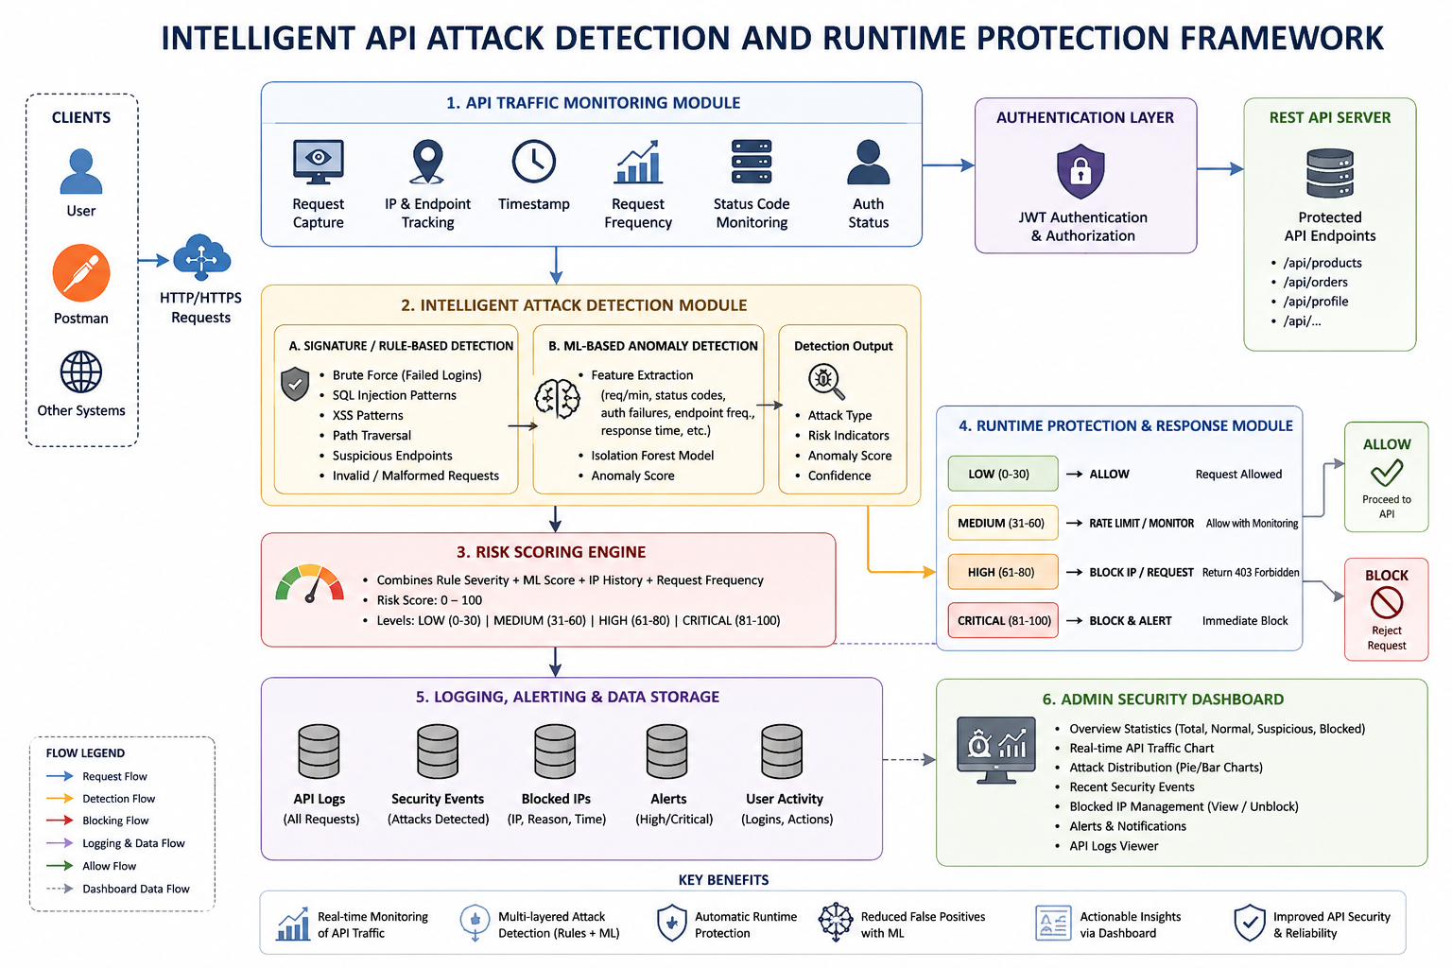
Architecture Diagram

Slide 6
Module 1: API Traffic Monitoring Module
Continuously monitors incoming and outgoing API requests.
Collects request details such as IP address, endpoint, method, and timestamp.
Tracks authentication and authorization activities using JWT/OAuth.
Applies rate limiting to identify excessive or suspicious API requests.
Maintains security logs for real-time monitoring and further analysis.

Slide 7
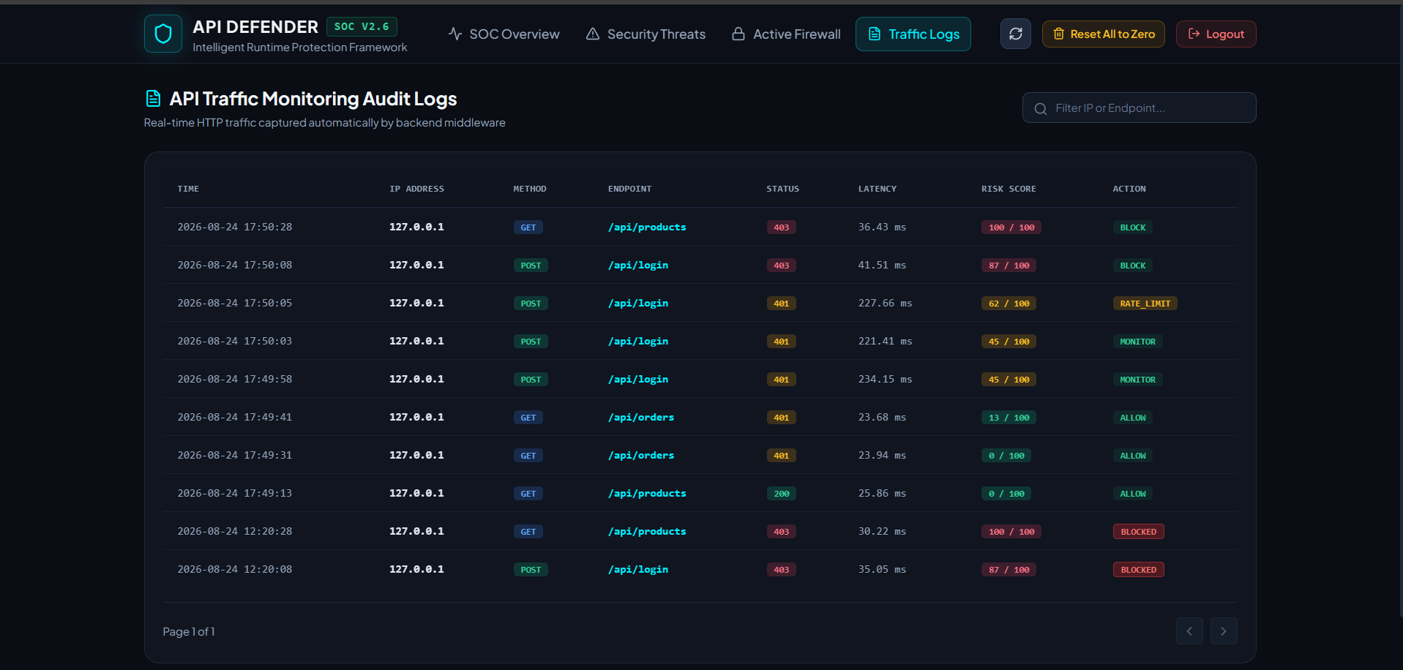
Module1 Output

Slide 8
Module 2:Intelligent Attack Detection Module
Analyzes API traffic to identify abnormal request behavior.
Uses machine learning and anomaly detection to identify unknown attacks.
Uses signature-based detection to recognize known attack patterns.
Detects threats such as injection attacks, unauthorized access, and request flooding.
Generates alerts and attack classifications for suspicious API activity.

Slide 9
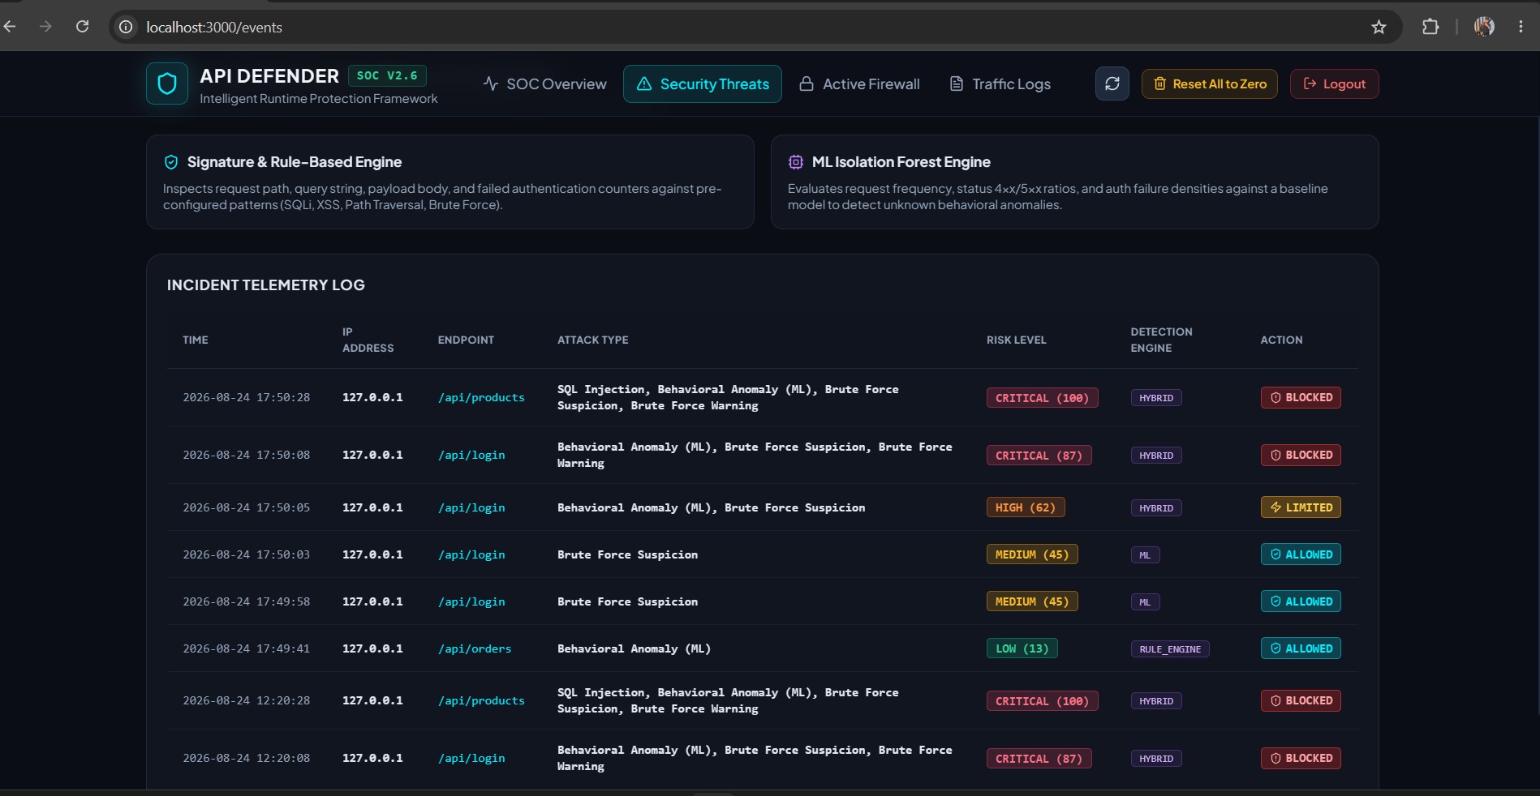
Module 2 Output

Slide 10
Module 3:Runtime Protection & Response Module
Automatically blocks requests identified as malicious.
Uses IP blocking and rate limiting to prevent repeated attacks.
Applies WAF-based protection against common web and API threats.
Provides immediate response to reduce the impact of security incidents.
Records response actions and security events for administrator analysis.

Slide 11
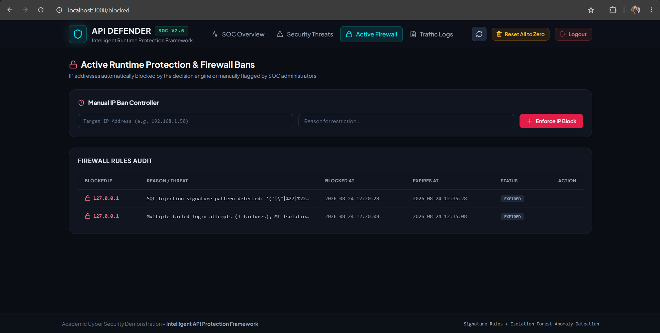
Module 3 Output

Slide 12
Future Work
Advanced ML Models – Use deep learning and more advanced anomaly-detection models to improve attack detection accuracy.
Real-Time WAF Integration – Integrate the framework with a production-grade Web Application Firewall for stronger protection.
Cloud Deployment – Deploy the system on cloud platforms to protect APIs at larger scale.
Advanced Threat Intelligence – Integrate threat-intelligence feeds to identify known malicious IPs and emerging attack patterns.
Automated Response & Scalability – Improve automated incident response and support large-scale API environments with distributed monitoring.

Slide 13
Conclusion
The framework provides intelligent and real-time protection for REST APIs.
Combining machine learning with signature-based detection improves threat identification.
Automatic blocking reduces the response time to malicious activities.
Monitoring, logging, and analytics help administrators understand API security risks.
The system improves API security, availability, and overall runtime protection.

Slide 14
References
OWASP API Security Top 10 – Guidelines for identifying and mitigating major API security risks.
OWASP API Security Testing Framework – Reference for API security testing and validation techniques.
OWASP Top 10: 2025 – Reference for common web application security risks such as injection, authentication failures, and security logging.
Scikit-learn – Isolation Forest – Documentation for the anomaly-detection algorithm used in the ML module.
Flask Documentation – Reference for developing the REST API backend and middleware.
OWASP API Security Tools – Reference for API runtime security and tools designed to detect and prevent malicious API requests.
OWASP API Security Project – General security guidance and best practices for designing and securing APIs.

Slide 15
Thank You!

